Slide 1





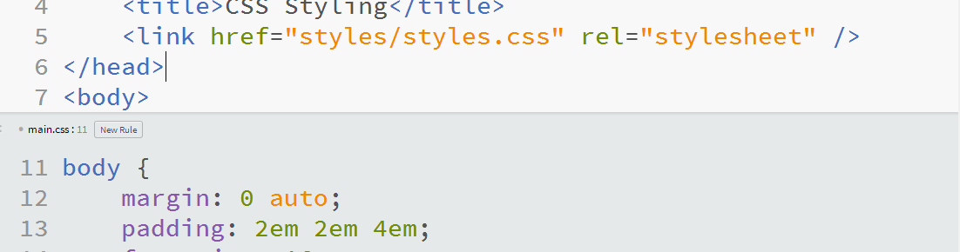
Web Fundamentals (HTML and CSS)
Course Introduction
Web Fundamentals
SoftUni Team
Technical Trainers
Software University
http://softuni.bg

Slide 2



Table of Contents
Course Objectives
Course Program
Trainers Team
Course Schedule
Exams and Evaluation
Learning Resources

Slide 3

Web Fundamentals (HTML + CSS)
Course Objectives & Program

Slide 4


Web Fundamentals – Course Topics
Web Technologies Basics - History, Pages, Site, Applications, Tools…
HTML Overview - Document Structure, Basics Tags, Elements
HTML Tables
Semantic HTML - HTML5 tags and rules
CSS Overview
CSS Presentation - CSS Properties. Styling text, boxes...

Slide 5

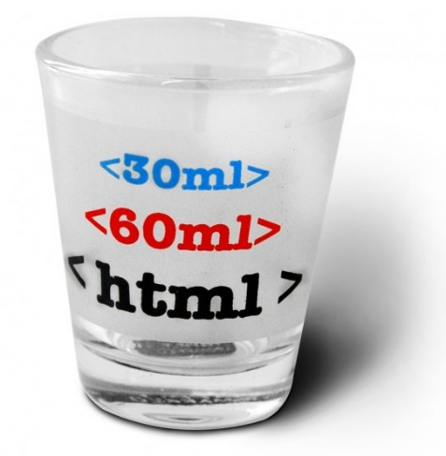
Web Fundamentals – Course Topics (2)
HTML Forms
CSS Layout & Positioning
Lab on All Course Material
Responsive Design. Bootstrap
Exam Preparation
Workshop
Practical Exam

Slide 6

The Trainers Team

Slide 7

Trainers Team
Nikolay Bankin
Top performing student from the Software University (2014)
Software Engineer at hacker.works

Slide 8

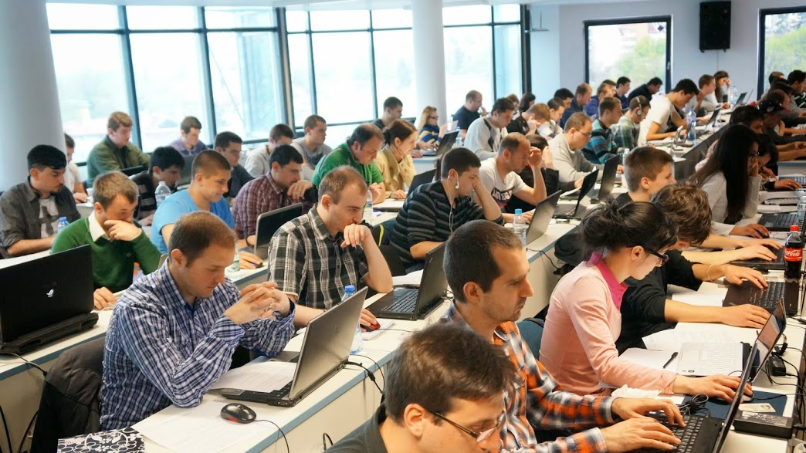
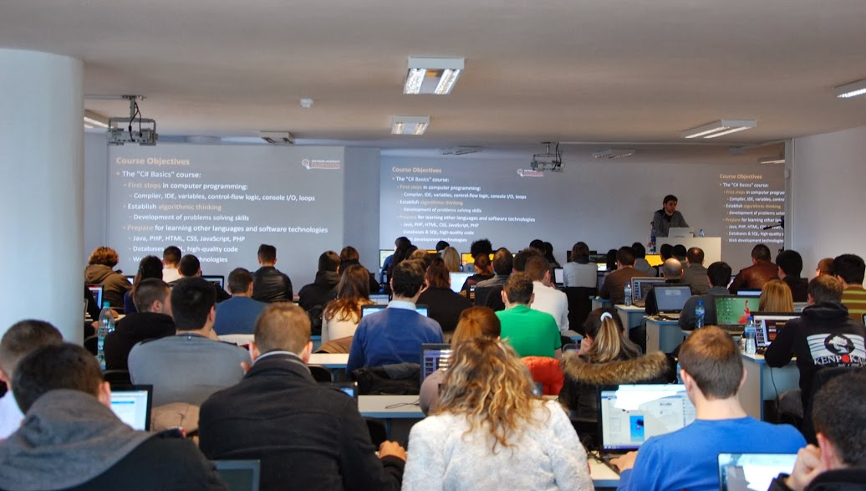
Volunteer Teaching Assistants
Volunteer teaching assistants
Developers from the software industry
Scholarship students from SoftUni

Slide 9

Web Fundamentals: More Details
Duration, Languages, Technologies

Slide 10


Training Duration – Web Fundamentals
Lectures: ~ 20 hours (onsite + YouTube videos)
Practical exercises (in class): ~ 20 hours
Homework: ~ 30-50 hours
Exam preparation: 4 hours
Exam: 6 hours
Schedule: Aug – Sep 2016
Exam date: 2-Oct-2016

Slide 11
Why HTML & CSS?
HTML & CSS – standard for Web UI
Web-based application are very popular
Runs on any device with a Web browser
HTML5 is currently the #1 job trend based on the fastest growing keywords found in online job postings
HTML5 will get better and better and take bigger chunk of the mobile application market
Every IT professional should know HTML & CSS

Slide 12



Why English?
Why the slides are in English?
English is the native language of the software engineers
Specific terminology should be in English
Translations are inaccurate and funny
Just learn English!
No excuses

Slide 13



Web Fundamentals
Evaluation Criteria

Slide 14



Scoring System for the “Web Fundamentals”
Exam – 90%
Homework + evaluation – 5% + 5%
Forum activity – bonus up to 10%

Slide 15
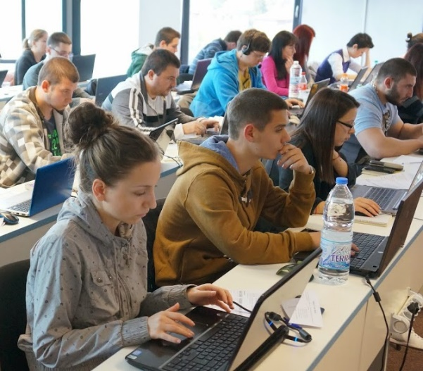
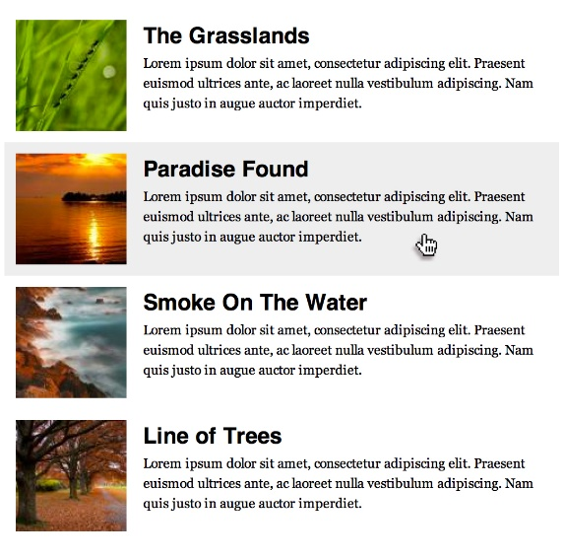



Web Fundamentals Exam
Practical HTML & CSS exam
You will be given a set of images
You should create the HTML & CSS
Sample exam problem:
+

Slide 16

Homework Assignments
Doing your homework is very important!
Programming can only be learned through a lot of practice!
You should write code every day!
Each lecture is followed by a few exercises
Try to solve them in class
The rest are your homework
Homework assignments are due in 6 days after each lecture
Submission will be accepted through our web site: softuni.bg

Slide 17

Homework Peer Reviews
Give feedback to a few random homework submissions
Students submit homework anonymously
Please exclude your name from the submissions!
For each homework submitted
Students evaluate 3 random homeworks
From the same topic, after the deadline
Give written feedback, at least 200 characters
Low-quality feedback → report for punishment
Everyone will get feedback for their homework

Slide 18









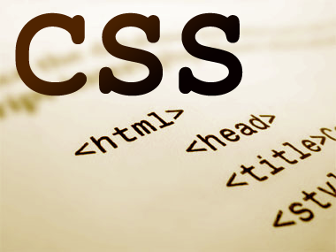
Resources
What We Need Additionally?

Slide 19

Course Web Site & Forums
The Web Fundamentals official web site:
Register for the "Software University Forum":
Discuss the course exercises with your colleagues
Find solutions for all course exercises
Share source code / discuss ideas / help each other
https://softuni.bg/courses/web-fundamentals/
https://softuni.bg/forum

Slide 20



Slides and Videos
All lecture slides, videos, homework assignments, projects and other resources are open content, available for free
Visit the course web site to access the course resources

Slide 21

HTML & CSS Tutorials
HTML & CSS @ Codecademy
http://www.codecademy.com/tracks/web
W3School HTML Tutorial
http://www.w3schools.com/html/
Learn to Code HTML & CSS
http://learn.shayhowe.com/html-css/
CSS Tricks
http://css-tricks.com

Slide 22

Software University Learning System (SULS)
Software University Learning System (SULS)
www.softuni.bg
Important resource for students
Homework submissions
Homework check-up
Exams and results
Reports about your progress
…

Slide 23


Recommended Software
You will need a text editor, e.g.
Notepad++
You may try many HTML authoring tools like:
Sublime Text / Atom
Brackets
Aptana Studio
Microsoft Visual Studio
Netbeans
Webstorm

Slide 24


Summary
The "Web Fundamentals" course teaches
The first steps in HTML & CSS
Training program
HTML, Tags, Tables, Forms, Semantic HTML, CSS, Styles, Positioning, Layout, Responsive
Practical exam
Form image to HTML & CSS + score system
Learning resources
Lectures, videos, software, books, forum
HTML & CSS

Slide 25








Web Fundamentals (HTML and CSS)
https://softuni.bg/courses/web-fundamentals

Slide 26

License
This course (slides, examples, demos, videos, homework, etc.) is licensed under the "Creative Commons Attribution-NonCommercial-ShareAlike 4.0 International" license
Attribution: this work may contain portions from
"HTML Basics" course by Telerik Academy under CC-BY-NC-SA license
"CSS Styling" course by Telerik Academy under CC-BY-NC-SA license

Slide 27






Free Trainings @ Software University
Software University Foundation – softuni.org
Software University – High-Quality Education, Profession and Job for Software Developers
softuni.bg
Software University @ Facebook
facebook.com/SoftwareUniversity
Software University @ YouTube
youtube.com/SoftwareUniversity
Software University Forums – forum.softuni.bg

